Slide 1
Generative AI for Business
Liwei Chen
University of Cincinnati
2026 IT Teaching Workshop
May 15, 2026
Notes:
Note to instructor: (optional) Input animations as you see fit.

Slide 2
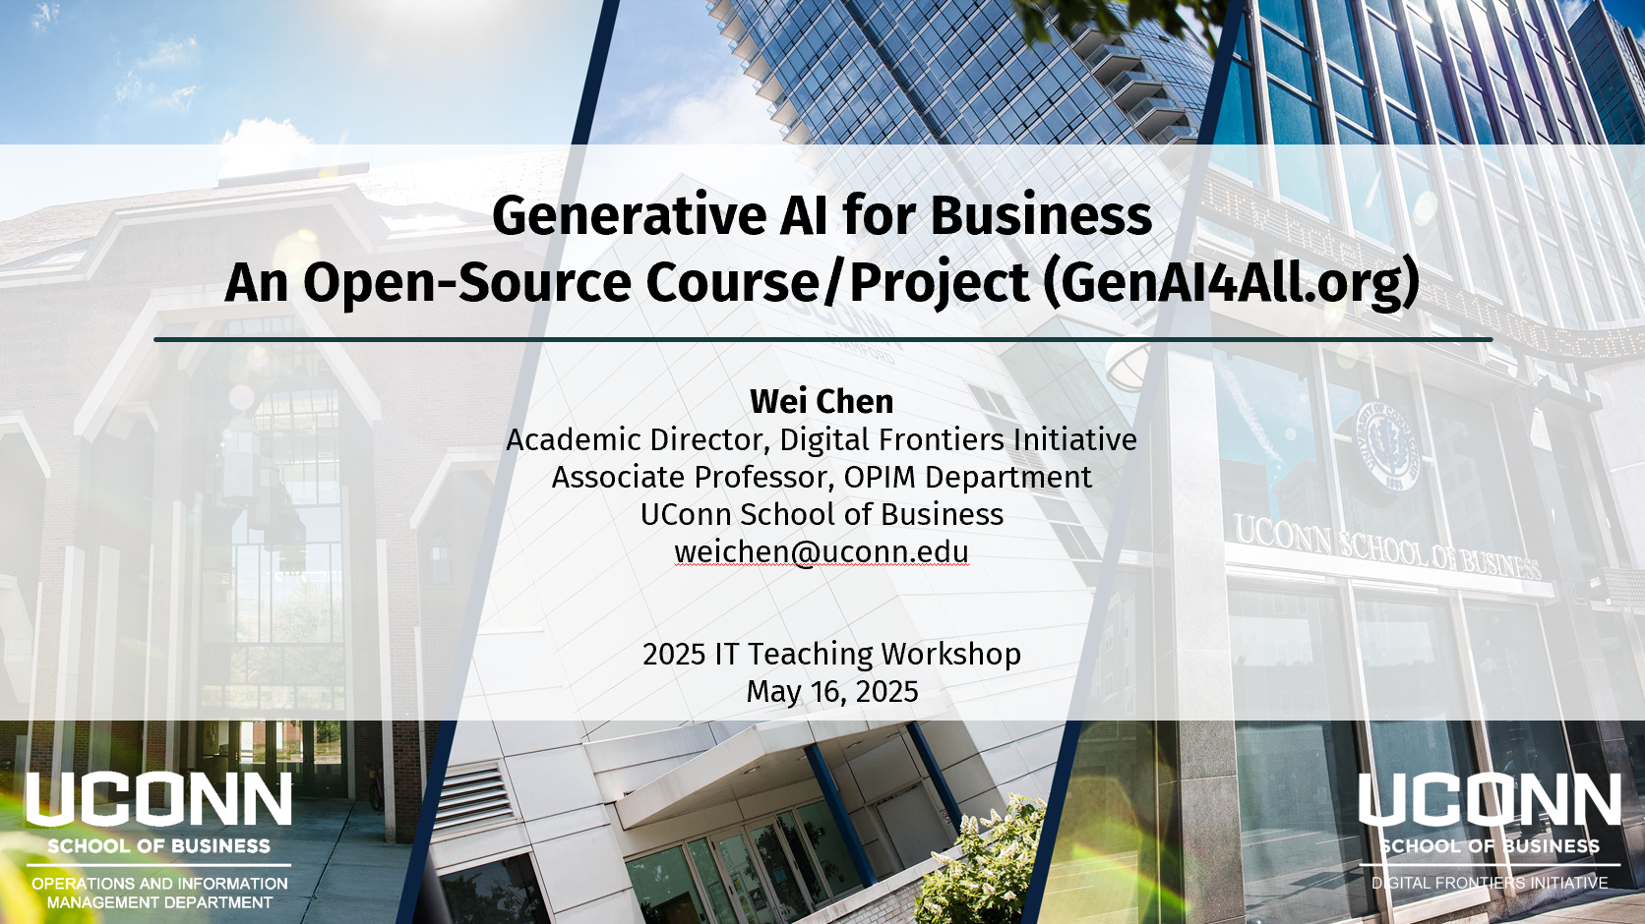
Follow-Up on the GenAI4All Initiative

Slide 3
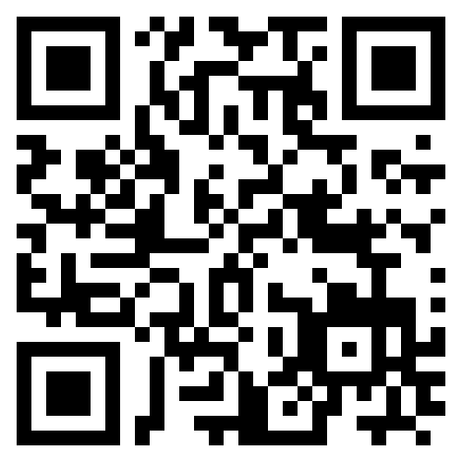
Agenda
Textbook
Course
Course Materials
Moving Forward
genai4all.org

Slide 4
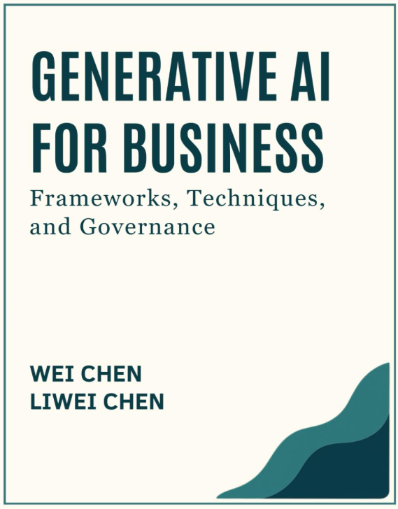
Textbook Released
Amazon
  Paperback
  Hardcover
  Kindle
VitalSource eBook
  Lifetime access
  150 days rental
  Free instructor copy

Slide 5
Textbook Content
Introduction
Architecture
Prompt Engineering
Retrieval-Augmented Generation
Agentic Systems
Fine-tuning
Challenges
GenAI Engineering and Operations
Responsible Integration of GenAI

Slide 6

GenAI for Business Course
Programs
  MS-IS, MS-Business Analytics, MBA
  Undergraduate-IS
  Applied AI Certificate
Mode
  In-person, online, hybrid
  7 weeks, 14 weeks

Slide 7
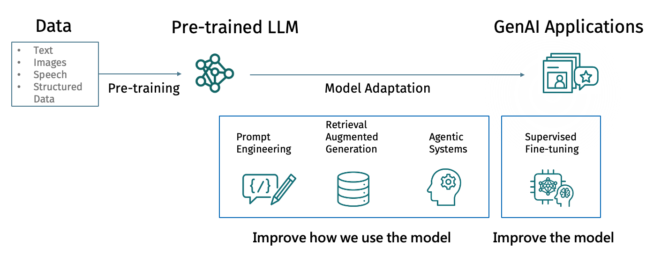
Course Roadmap

Slide 8
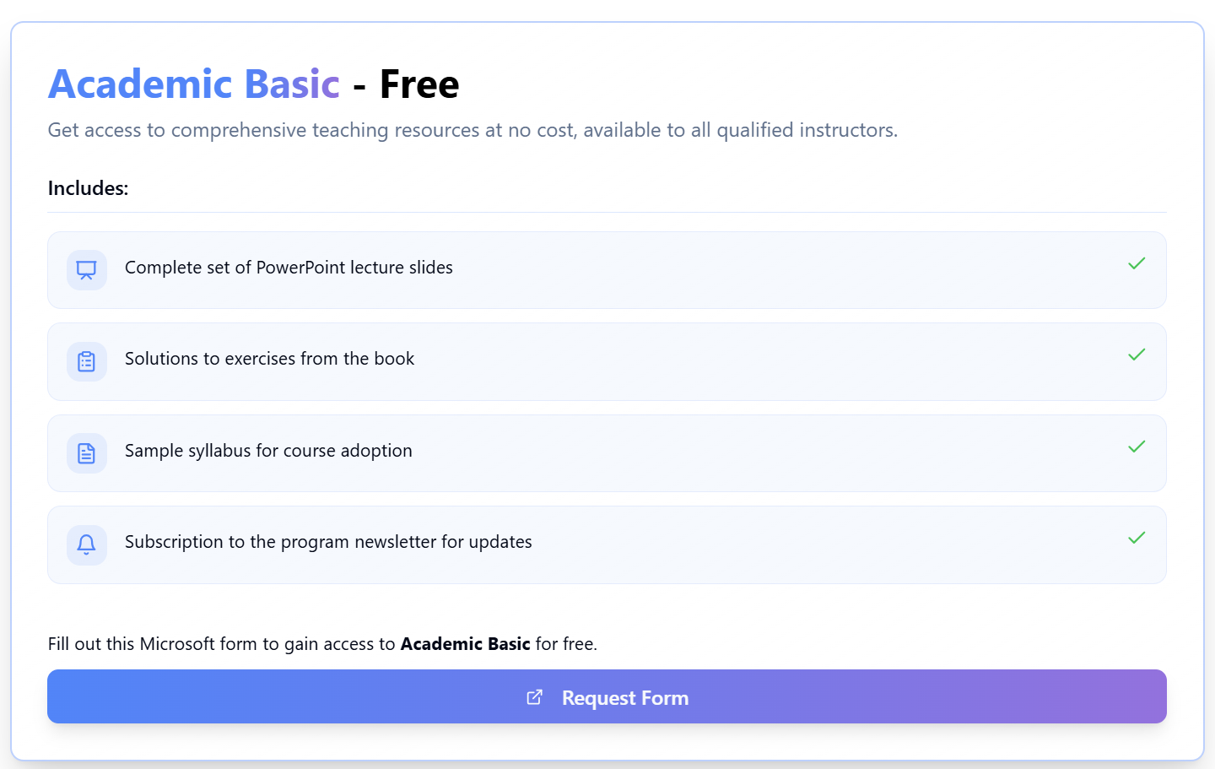
Course Materials

Slide 9
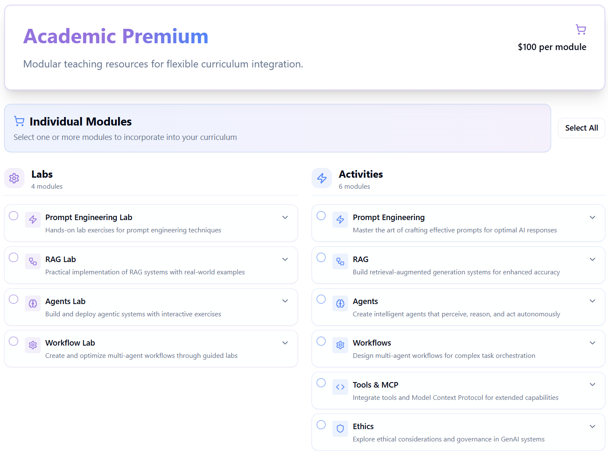
Course Materials

Slide 10
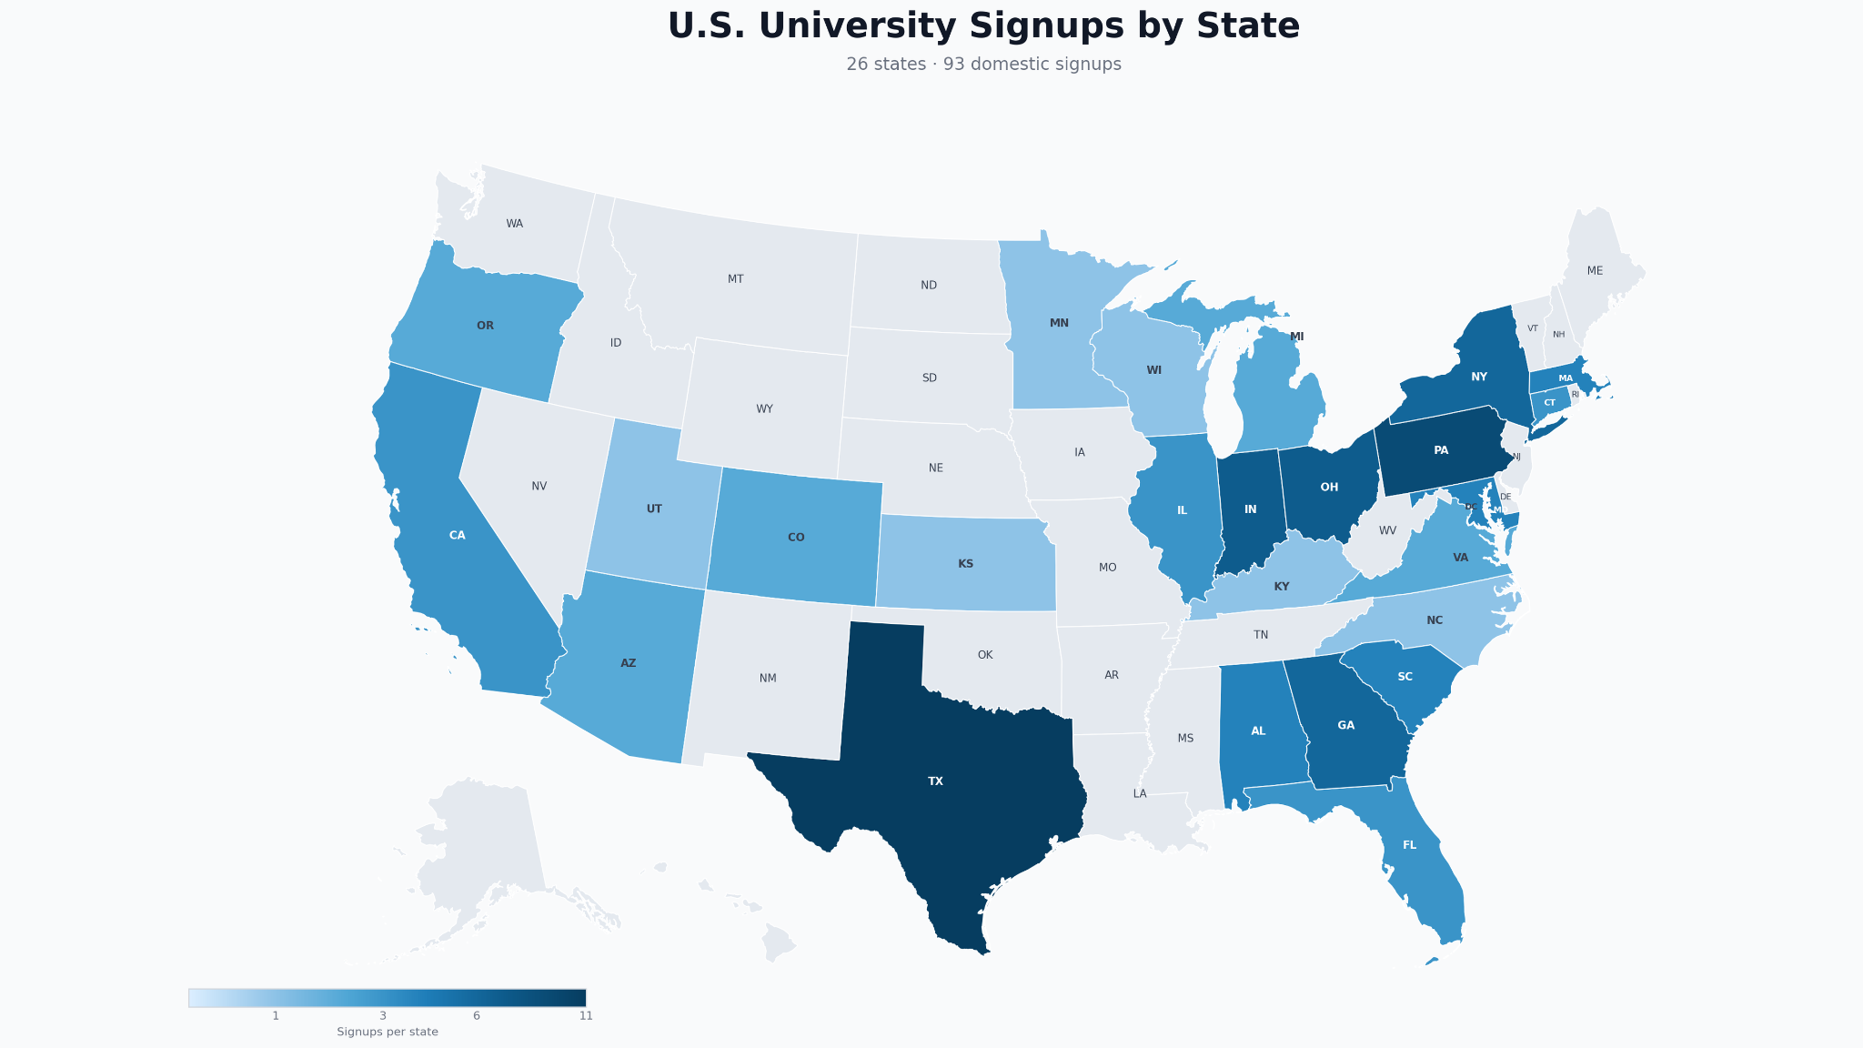

Slide 11
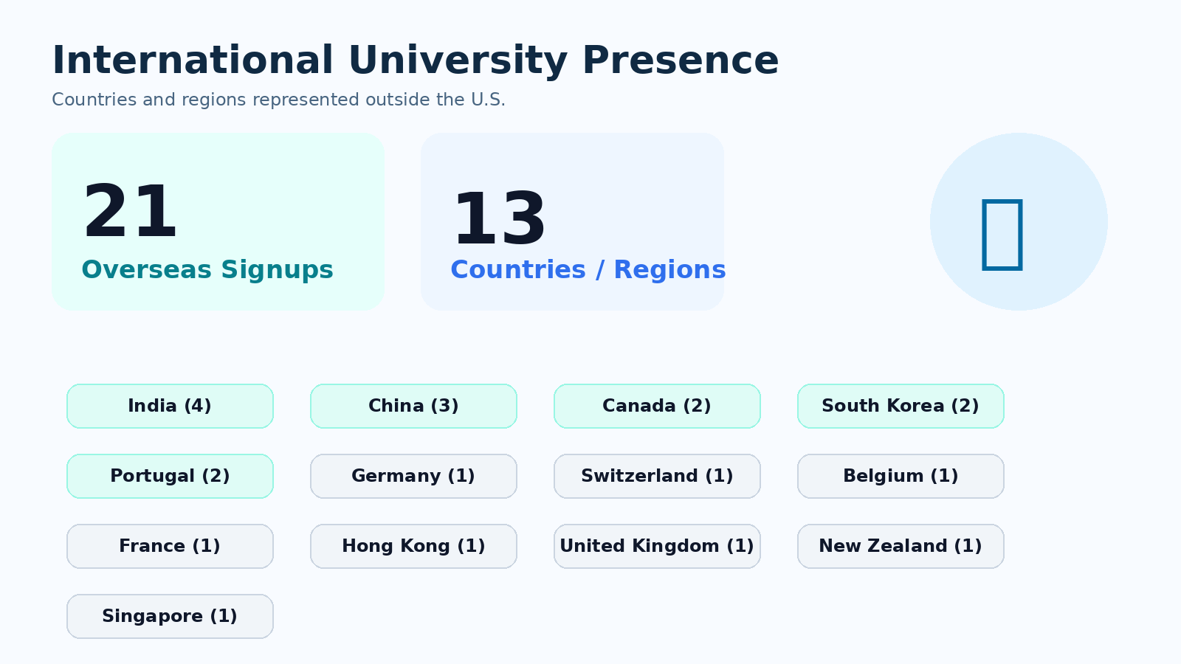

Slide 12

Moving Forward
Textbook 2nd edition
  Knowledge retrieval
  Agent skills
  Coding agents
  Harness engineering
  Governance framework
  Multimodal
  Monitor and evaluation
Course materials updating
  Additional class activities
  Labs on Gemini CLI, MCP, vibe coding

Slide 13
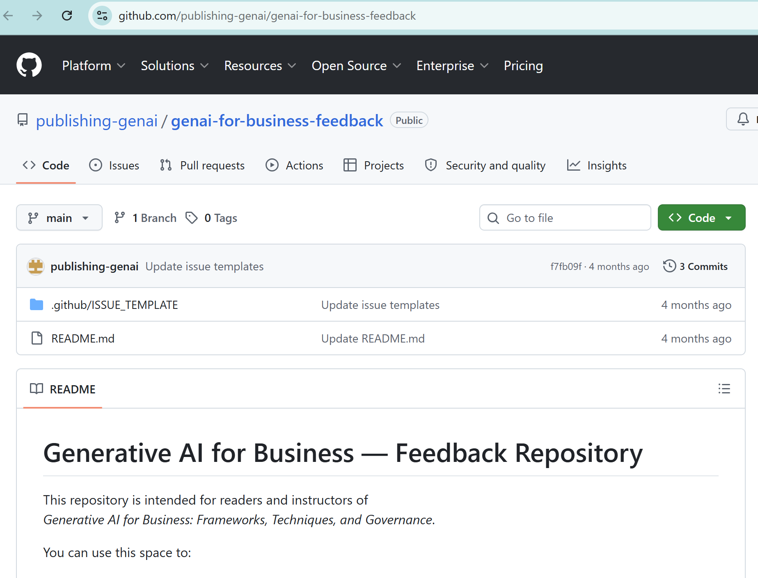
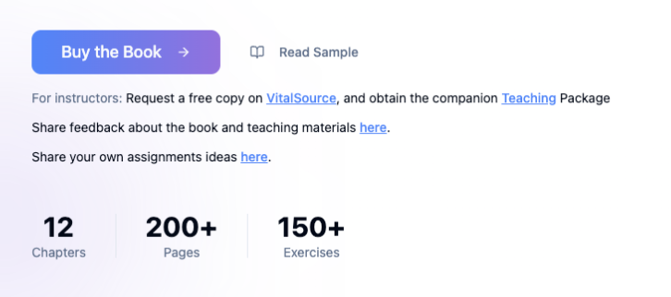
We Need Your Contribution!
Share feedback and propose changes to our textbook via our GitHub repository

Slide 14
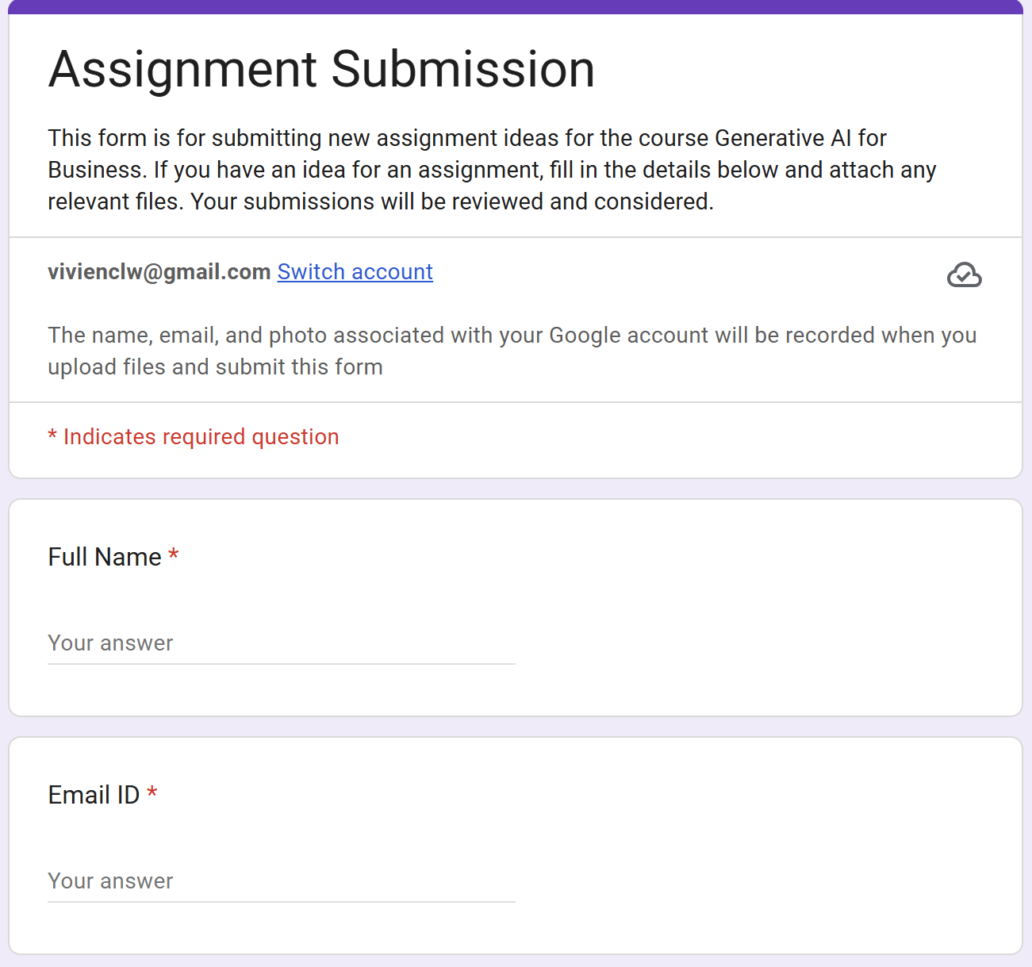
We Need Your Contribution!
Share your teaching materials as New Modules on our platform
  including but not limited to in-class activities and homework assignments
  adapted to your own topics and application contexts

Slide 15
Q & A
Wei Chen
weichen@uconn.edu
University of Connecticut
Liwei Chen
liwei.chen@uc.edu
University of Cincinnati

