Slide 1

IT TEACHING WORKSHOP
Prescriptive Analytics in Action:
Optimizing Portfolios with Python
By Osman Kazan
Freeman School of Business · Tulane University

Slide 2
Background
INTRODUCTION
TEACHING PORTFOLIO
Extensive consulting experience with HP, serving clients including Walmart, Bank of America, etc.
13 years of teaching, research, and directed the MSBA program since inception.
SQL & Business Intelligence
Advanced Spreadsheet Modeling
Operations & Supply Chain Management
Global Supply Chains
Business Statistics
Energy Data Analysis
Business Analytics with Python
Several Cases / In-class Projects:
Simulation March Madness Tournament
Portfolio Optimization
Wordle Game
…
TEACHING LEVELS
Undergraduate
Graduate
Executive
RESEARCH INTERESTS
Operations Management
Supply Chains · Logistics · Teaching Analytics
Energy
Electricity Pricing · Data Analysis · Sustainability
Healthcare
Epidemic & Public Health Management

Slide 3
MGSC 4790 · Business Analytics with Python
Designed as a junior/senior-level experiential learning course in business analytics with applications from Operations, Information Systems and Finance.
COURSE DESCRIPTION
A hands-on course teaching Python for business analytics across finance and operations. Covers four areas --descriptive analytics, prescriptive analytics (optimization & simulation), predictive analytics (forecasting), and visualization --applied to real-world business data. Students complete a team project optimizing and simulating investment portfolios of their choice.
Business Analytics and AI Certificate:
MGSC 4790 is a core required course in Freeman's Business Analytics & AI Certificate - a 12-credit program preparing students for high-growth careers in data-driven strategy using Python, Tableau, and Power BI.
01
Descriptive Analytics
Data essentials & imports (NumPy, Pandas…)
02
Prescriptive Analytics
Optimization, Monte Carlo Simulations
(NumPy, SciPy)
03
Predictive Analytics
Forecasting & time series w/ seasonality
(StatModels, sklearn, Darts)
04
Visualization
Throughout all subject matters
(MathPlotLib, Seaborn and Plotly)
No Pre-requisite; only foundational knowledge in any programming language recommended.

Slide 4
Team Project · Portfolio Optimization Overview
TEAM
INDUSTRY
Junior and senior business students -- spanning diverse majors and coding backgrounds -- apply descriptive and prescriptive analytics to build their own optimized investment portfolios.
Tyler, Hudson & William
Defense
Kelsey, Elle & Olivia
Fashion / Consumer Goods
01
Juan, Nastassja & Jessica
Airlines
Stock Selection
Each team selects stocks from industries of their choosing -- sector analysis & diversification rationale
Chloe, Quentin & Marina
Healthcare
Natalie, Coco & Whitney
Automotive
02
Descriptive Analytics
Rudyard, Maria Clara & Nicolas
Finance
Historical returns, correlations, risk profiles -- real-time data via yfinance, Pandas, Seaborn
Chloe L., Carley & Annika
Entertainment
Joshua, Aidan & Will B.
Energy
03
Prescriptive Analytics
Grayson, Reginald & Jingyi
Biopharmaceuticals
Mean-variance optimization, efficient frontier modeling, Monte Carlo simulations with SciPy
Alex, Gabe & Griffin
Sports
04
Final Deliverable
Caitlin, Cosette & Gordie
Food & Beverage
Dynamic Plotly charts, optimized portfolio report
Jordan & Megan
Fast-Food
Python Stack: NumPy · Pandas · SciPy · Seaborn · Plotly · yfinance + AI-assisted coding

Slide 5
Student Example ·
Healthcare Portfolio -- Stock Selection & Data Pipeline
PORTFOLIO RATIONALE
DATA PIPELINE
Starting from 6 diversified base assets, the team expanded to include 6 Healthcare stocks -- chosen for their defensive nature, steady demand, and strong sector growth potential.
01
yfinance Download
Monthly adj. closing prices · 2016–2026 · 12 assets
02
Log Returns
BASE ASSETS
AAPL -- Apple (Technology)
IBM -- IBM Corp (Technology)
XOM -- ExxonMobil (Energy)
DAL -- Delta Air Lines
HBCP -- Home Bancorp (Finance)
Gold Futures (Commodity)
r_t = ln(P_t / P_{t-1}) -- time-additive, near-normal
03
Descriptive Stats
Mean, std, skew, kurtosis per asset · .describe()
04
Correlation Matrix
HEALTHCARE EXPANSION
Pairwise heatmap -- identifies diversification benefits
PFE -- Pfizer
JNJ -- Johnson & Johnson
UNH -- UnitedHealth
CVS -- CVS Health
LLY -- Eli Lilly
GILD -- Gilead Sciences
05
Covariance Matrix
Core risk input for optimization · σ²_p = w'Σw
06
Annualized Volatility
σ_A = σ_M × √12 · square-root-of-time rule

Slide 6
Descriptive Analytics · Returns, Risk & Correlation
WHAT STUDENTS EXPLORE
KEY LEARNINGS
Return Distribution -- mean log return & std deviation per asset, risk/reward profile
Risk Comparison -- Gold (low-vol safe haven) vs. AAPL (high-growth), annualized via σ_M × √12
Correlation Heatmap -- px.imshow(), which assets diversify vs. which move together
Covariance Matrix -- core optimization input, diagonal = individual asset variances
Equal-Weight Baseline -- benchmark portfolio, variance via quadratic form w'Σw
Diversification works -- low correlations between Healthcare & Energy reduce overall portfolio variance
Risk ≠ Return -- high-volatility stocks don't always yield proportionally higher returns
Real market data -- 2015–2025 captures COVID, rate hikes, sector rotations; students feel it
Python fluency -- Pandas, px.imshow() heatmaps, Seaborn histograms, all in one workflow

Slide 7
Prescriptive Analytics · Optimization, Efficient Frontier & Monte Carlo
MEAN-VARIANCE OPTIMIZATION
MONTE CARLO SIMULATION
01
Objective
5,000 Random Portfolios -- Dirichlet weights always sum to 1, maps the full feasible opportunity set
Efficient Frontier Overlay -- optimized curve hugs the upper-left edge of the Monte Carlo cloud
Sharpe Proxy Coloring -- scatter colored by return/risk ratio, students see efficiency zones visually
1,000 Return Scenarios -- per-asset normal draws × optimal weights → portfolio return distribution
VaR & CVaR -- 95% Value-at-Risk and Conditional VaR annotated on the return histogram
Minimize portfolio variance w'Σw subject to constraints
02
Constraints
(1) Return ≥ r* (2) Σw = 1 (3) Long-only: 0 ≤ w ≤ 1
03
Solver
scipy.optimize.minimize with SLSQP -- converges to global optimum
04
Efficient Frontier
80-point sweep from r_min to r_max traces the full optimal curve
05
Optimal Weights
Single solve at 1%/month floor -- asset allocation vector output

Slide 8
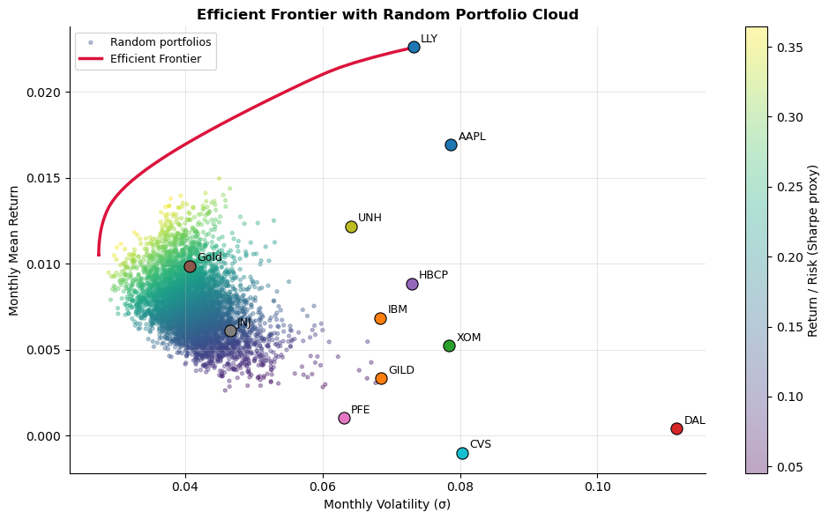
Results · Efficient Frontier & Monte Carlo Cloud
KEY METRICS
Optimal Return: 12.0% / year (1% / month target)
Optimal Volatility: ~9.9% / year (minimum for target return)
Monte Carlo: 5,000 random portfolios, Dirichlet-sampled weights
Frontier Points: 80 solved optimizations, SLSQP solver

Slide 9
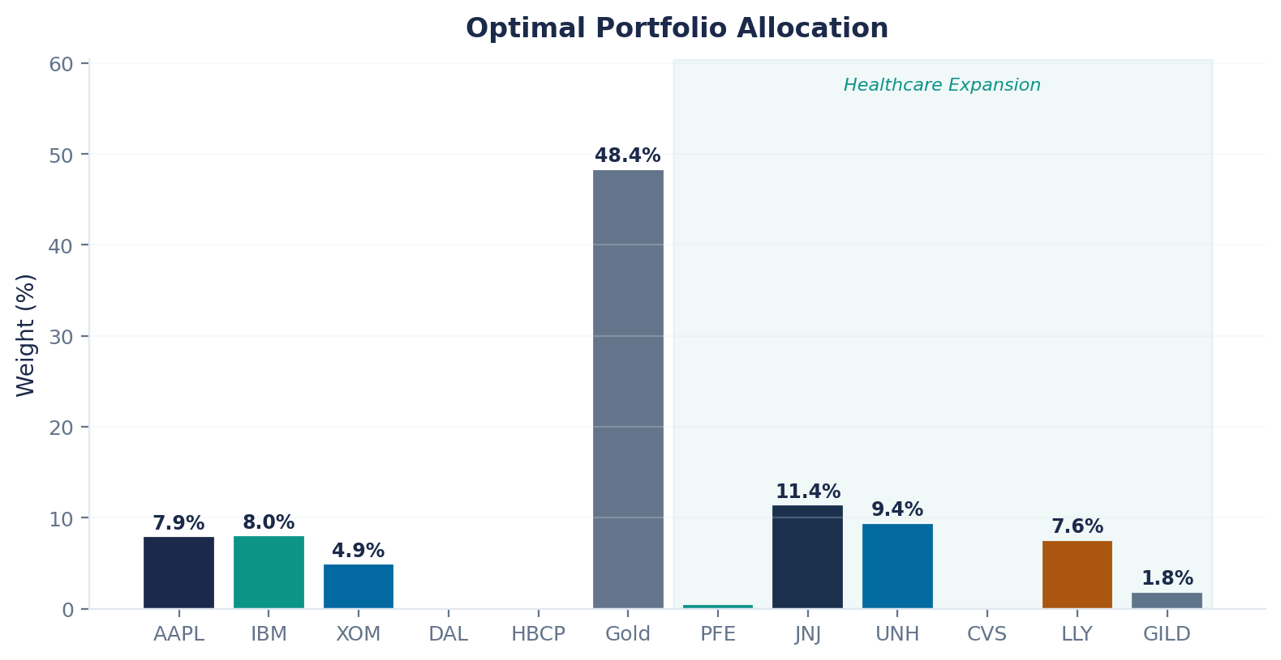
Results · Optimal Portfolio Allocation
Gold 48.4%
JNJ 11.4%
UNH 9.4%
IBM 8.0%
AAPL 7.9%
LLY 7.6%
XOM 4.9%
GILD 1.8%
Gold dominates as the minimum-variance anchor (low correlation with equities). Among Healthcare stocks, JNJ and UNH carry the highest allocation reflecting lower volatility relative to return.

Slide 10
Pedagogical Takeaways
FINAL DELIVERABLE OUTPUTS
PEDAGOGICAL TAKEAWAYS
Efficient Frontier -- Monte Carlo cloud + optimized curve, Matplotlib & Seaborn
Optimal Allocation -- bar chart, % per stock at minimum variance for target return
Return Distribution -- histogram with normal PDF overlay, VaR & CVaR markers
Portfolio Metrics -- monthly & annual volatility, return, Sharpe proxy
Live Team Presentation -- Plotly interactive charts presented to the class
Theory meets practice -- Markowitz portfolio theory applied to self-chosen real stocks
Coding for all levels -- AI tools bridge skill gaps, every student delivers quality work
Interdisciplinary -- Finance, OM, IS and data science converge in one project
Pride in output -- students present dynamic, professional analysis to their peers
"Students transform financial theory into dynamic, presentation-ready analysis through genuine experiential learning."

Slide 11
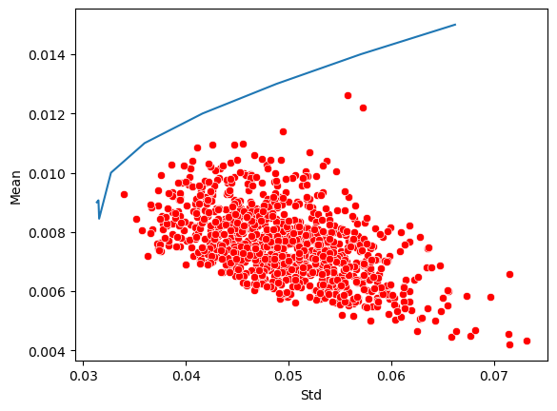
AI Effect: Before and After

