Slide 1
AI Co-Learning: Designing for Cognitive Ownership in the Age of Generative AI
De Liu
University of Minnesota | SmartPAL AI
IT Teaching Workshop | Irvine, CA | May 15, 2026

Slide 2
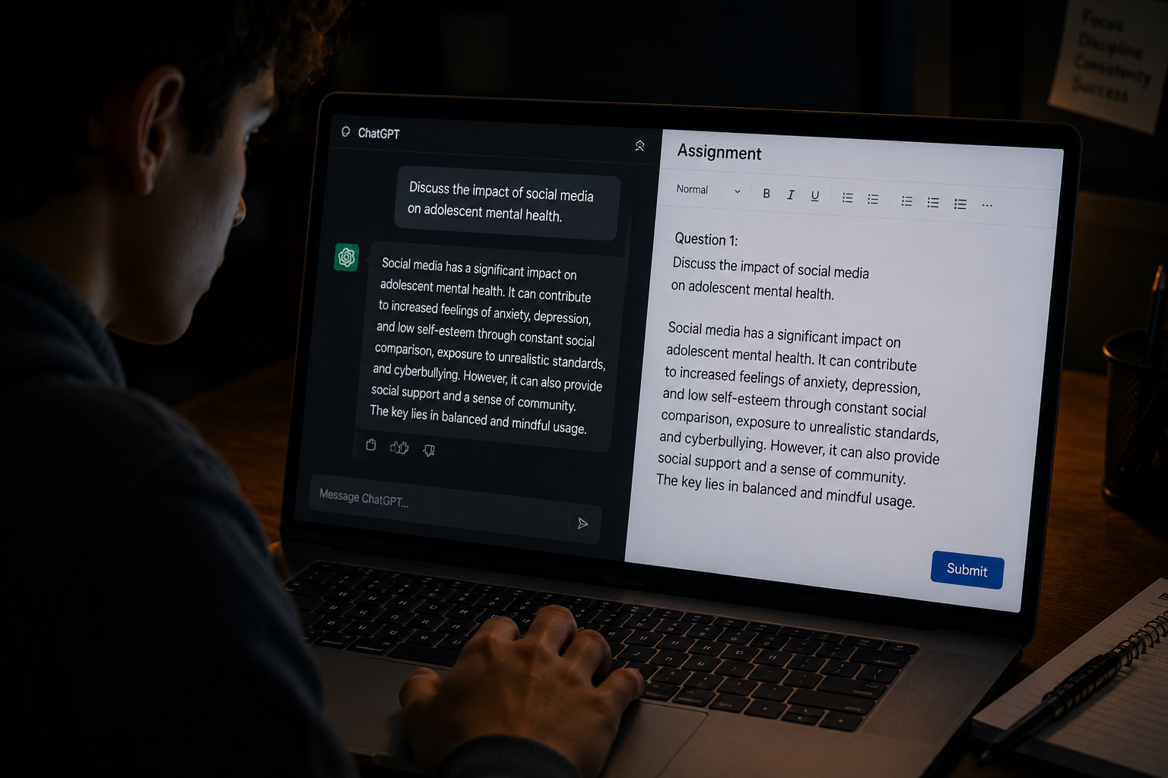
What Did They Learn?
It's 11 PM. A student opens the assignment. Reads the first question. Pauses for two seconds. Then opens a new tab — ChatGPT — and types the question in.
The answer arrives in eight seconds. The student pastes it, lightly edits, submits.
What did they learn?
“The purpose of an assignment isn’t just to produce a final product; it’s to engage students in the learning process.” -- Medium article
Notes:
https://medium.com/%40klaudel.b/how-ai-makes-students-dumb-and-what-we-can-do-about-it-eac690db46d5
High-school RCT (N=987): unrestricted ChatGPT improved practice scores 48% but reduced unassisted exam scores 17% (Bastani et al., 2025)
Knowledge workers (N=319, 936 use cases): higher confidence in AI is associated with less critical-thinking effort (Lee et al., 2025)
LLM-assisted writers show weaker neural connectivity (EEG); 83% cannot quote essays they had just produced (Kosmyna et al., 2025)

Slide 3

Is it the right approach?
Every instructor has a different approach to AI in the classroom — from banning it, to embracing it, to barely addressing it at all.
“I’d better not to risk anything by not using AI at all. Besides, I will learn more if I struggle through it myself.”
Is it the right approach?
The same tool could have been a productive learning partner.
The job market demands savviness with AI.
Notes:
"AI reduces cognitive effort. Learning requires it."
Field experiment evidence: students assigned to standard ChatGPT scored 4.18% lower on subsequent exams than those using a search engine — despite using ChatGPT 3.8× more (Li, Liu & Ye, 2026)
Mechanism: cognitive offloading — delegating effortful reasoning to AI displaces the productive struggle that drives learning
Lab corroboration: students who used AI showed weaker text ownership and difficulty quoting their own work (Kosmyna et al., MIT Media Lab, 2025)
⚠️ Effects are contingent — task format and chatbot design matter
Li, Liu & Ye (2026) — N=583 students, two field experiments, IS courses
Main idea: Modify what AI can produce through custom prompts, hint-only modes, fading scaffolds inside the tool itself.
Guardrail tutors: teacher-engineered prompts (~500 words/problem) suppress answers and provide hints; eliminate the 17% retention drop seen with unrestricted ChatGPT (Bastani et al., 2025, PNAS)
Domain-specific AI tutors: the “PS2 Pal” physics tutor outperforms in-class active learning when carefully prompted to give one-step hints, encourage attempts, and not reveal solutions (Kestin et al., 2025)
Fading scaffolds: adaptive systems that gradually reduce assistance preserve student agency and self-regulation (Darvishi et al., 2024)
Guided discovery: zero-shot prompting that breaks problems down without supplying answers raises exam scores, while remaining scalable (Li et al., 2025)
Limitation: Relies on forced adoption; hard to enforce when students have open access to public LLM tools

Slide 4
How are instructors coping?
Ban or Restrict AI for Certain Assignments (Still common)
AI-Transparent Assignments (fast growing)
  Disclosure AI, document AI prompts, Reflect on AI usage/outputs
AI-proof assignment
  but “There’s no AI-proof anything”
Shift Toward In-Class / Oral / Process-Based Assessment
Redesign assignments to explicitly incorporate “AI as a Tool”.
  Require use of AI, e.g., for brainstorming, critique, etc
  AI literacy becomes part of the goal

Slide 5
Our proposal
AI Co-learning
AI with Guardrails
The future of education is not AI-free learning, but AI-supported learning designed to preserve human thinking.
Structural Assurance
Trust cannot depend on policy alone; it must be reinforced through transparent learning processes and evidence of engagement
Shared Value Creation
Empower both sides of the classroom: helping students learn more effectively while enabling instructors to teach more effectively.

Slide 6
What Is AI Co-Learning?
AI Co-Learning: an integrated, pedagogically designed environment where:
AI acts as a constrained thinking partner — not a replacement
Students own the core cognitive work — structurally, not just by policy
Deployed as an LMS-integrated assignment tool
“Co-learning” as in “co-work” (Claude) and “co-intelligence” (Ethan Mollick)
shared pace: AI and humans share a learning space
learning-focused: designed to preserve and enhance human learning
human-centered: Human owns key cognitive work.

Slide 7
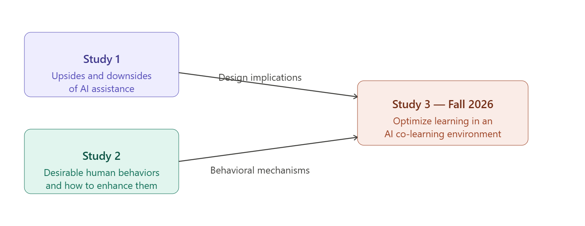
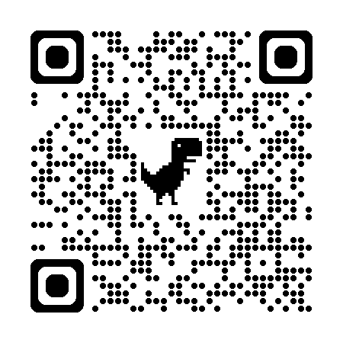
Road to AI Co-learning
Research-guided, iterative design with field deployment (via SmartPAL)
✔
Li, Liu, & Teng, Working paper

Slide 8
Study 2: Preserving Learning under AI Assistance
joint work with
Andy (Tao) Li | Azel Shokparova | Teng Ye

Slide 9
Motivation
How can we train learners to make the best use of AI for learning?
Literature is still very underdeveloped
  AI literacy frameworks:17 core competencies including “recognize AI limitations” and “critically evaluate AI outputs” (Long & Magerko, 2020; Ng et al., 2021)
  Generative AI literacy: extended frameworks addressing hallucination, context limits, prompting strategies (Zhang & Magerko, 2024; Annapureddy et al., 2024)
  Limitation:
    Lack causal evidence connecting these frameworks to learning outcomes
    Describes what users should know, not what they should do (Lee et al., 2025)

Slide 10
RQ: Do productive struggle and learner agency enhance learning outcomes in AI Co-learning?
Productive Struggle: actively working through challenges before receiving help or answers
Learner agency: the ability of students to actively direct, evaluate, and take ownership of their own learning process.
Why these two?
  Productive struggle activates prior knowledge promote effortful engagement during the assistance phase afterward (Kapur, 2016)
  Agentic engagement is a critical determinant of learning (Reeve & Tseng 2011) and deeper engagement (Taub et al., 2020)
  “AI-free first, AI assist next” appears to be gaining popularity

Slide 11

Research Context
A preliminary AI Co-learning environment with no optimization of AI design
An in-person session where students complete a written assignment with AI assistance
AI-free Draft → AI-Assisted Completion → Download & Submission

Slide 12
Experiment
A Spring 2026 Pre-registered field experiment
127 students across three business master courses (analytics and IS)
2×2 between-subjects experiment
  Struggle nudges: encourage students to draft an answer before seeking AI help
  Agency nudges: encourage students to own and control AI interactions
Outcomes:
  Draft completion (binary)
  Draft quality
  Ratio of high-agency prompts
  Assignment score
  Quiz score (closed book, matched to the assignment)

Slide 13
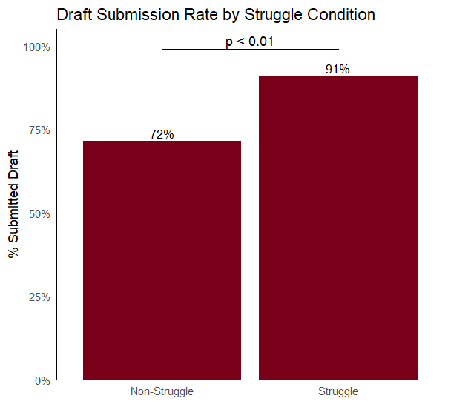
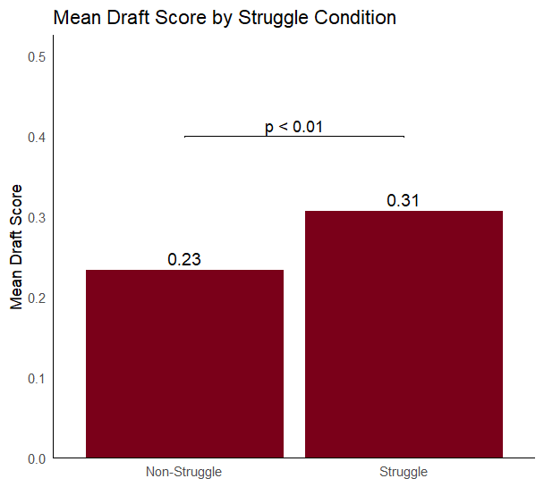
Preliminary findings based on one course (60 students, 240 questions)
Struggle nudges increase the draft completion rate (+19.6%, p<0.01)
Struggle nudges also increase draft quality (+30%, p<0.01)
Notes:
→ The struggle nudge increased the likelihood of writing an AI-free draft by 19.6 percentage points. The coefficient remains consistent after controlling for different questions (question fixed effects) and pre-experiment attitude toward struggle.
→ The struggle nudge increased AI-free draft quality by 0.07 units. The coefficient remains consistent after controlling for different questions (question fixed effects) and pre-experiment attitude toward struggle.

Slide 14
High vs Low-Agency Prompts
Examples of High-agency prompts
Ask a conceptual question not direct part of the assignment
Asks AI for evaluative feedback or opinion of the draft
Asks AI to address a specific weakness they identified in their work
Follow-up on a prior AI response by adding new direction or thinking
Checking AI response accuracy or requesting sources
Examples of non-high-agency prompts
Pastes the assignment question and asks the AI to generate an answer without direction
Asks AI to improve the ideas or argument without specific direction
Ask AI to improve grammar/formatting

Slide 15
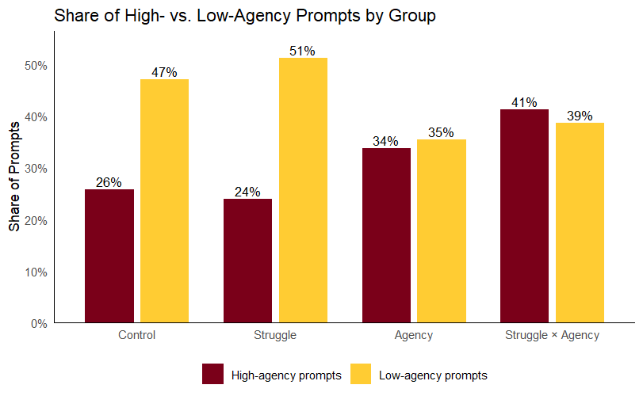
Ratio of High-agency Prompts
The agency nudge increased the proportion of high-agency prompts (+13%, p < 0.05).
Notes:
The agency nudge increased the proportion of high-agency prompts (+13%, p < 0.05).
The agency nudge increased the proportion of high-agency prompts by 13 percentage points (β = 0.13, p < 0.05). The coefficient remains consistent after controlling for different questions (question fixed effects) and pre-experiment attitudes toward agency.

Slide 16
Effects of Struggle on Exam Score
Total effect: Struggle nudges → Exam Score
  N.S.
Indirect effect: Struggle Nudges → Draft Score → Exam Score
  β = 0.017, p = 0.080
Suggestive but inconclusive
  Small sample may have limited power
Notes:
what kind of prompts are good predictors of the learning?

Slide 17
Effects of Agency Nudges on Exam Score
Total effect: Agency nudges → Exam Score
  β = -0.097, p = 0.070 (marginal)
Indirect effect: Agency Nudges → High-agency prompts → Exam Score
  β = -0.022, p < 0.05
Using AI with high-agency prompts negatively impacts learning
Notes:
what kind of prompts are good predictors of the learning?

Slide 18
Open Questions
Do nudges work in changing student AI behavior?
  Seems so but results may not transfer when AI interactions are unobservable.
Is AI-free attempt lead to enhanced learning?
  Promising but inconclusive
Why did enhanced learner agency hurt learning?
Who is helped or hurt by struggle/agency nudges?
Do we still need a specially designed AI environment?
  Most likely

Slide 19

Next Steps
We need to continue to develop our understanding what constitutes productive use of AI from learning standpoint.
Move from nudges to a fully-designed AI Co-Learning environment, Including
  Customizable and adaptive AI-driven nudges
  Capitalization of learning process intelligence
We would like to evaluate AI Co-learning
  At multiple sites
  For different course, assignment formats
If you’re interested, we'd love to connect.

Slide 20

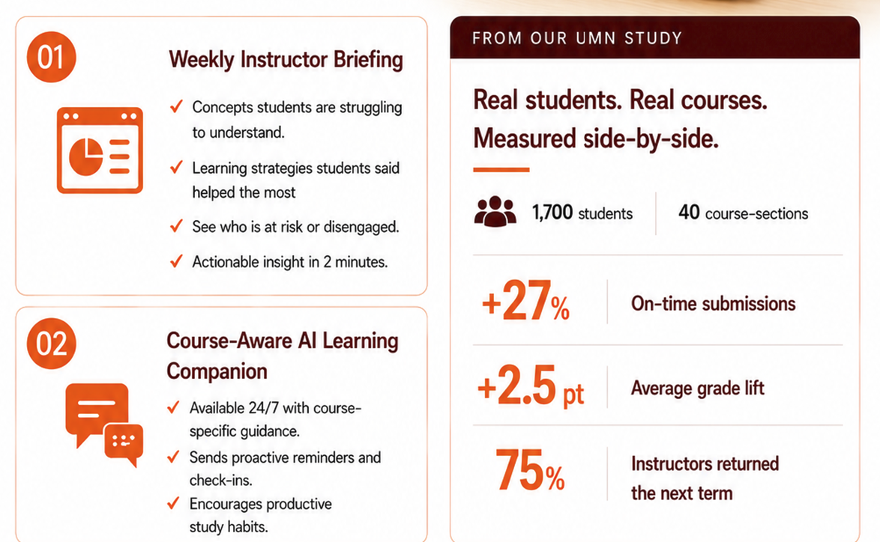
Invitation to Collaborate on AI Co-Learning Pilots

Slide 21
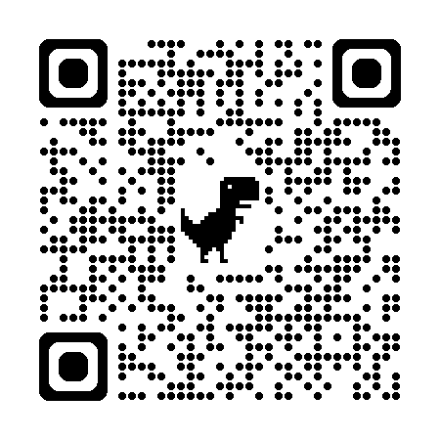
Thank You deliu@umn.edu
Follow SmartPAL on LinkedIn

Slide 23
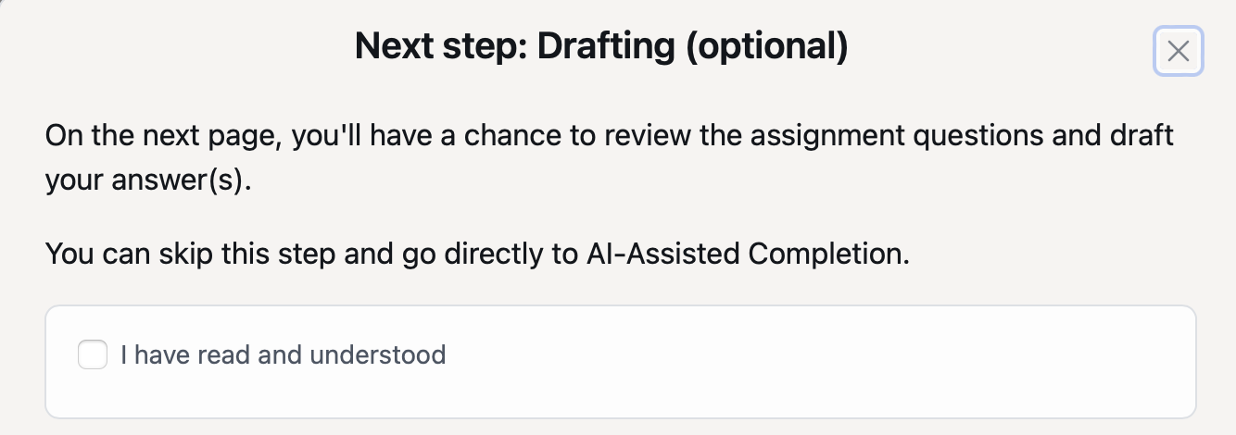
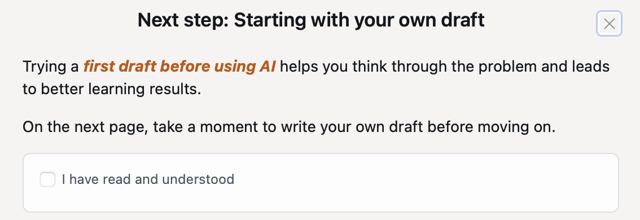
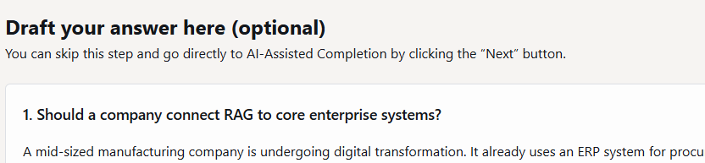
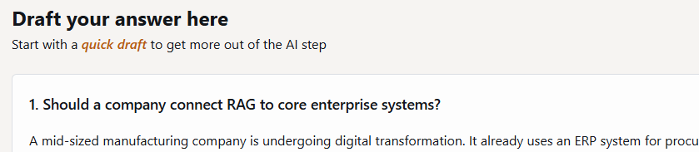




Treatment 1: Nudges to induce productive struggle
Non-struggle group
Struggle group
Notes:
put next button screenshot

Slide 24
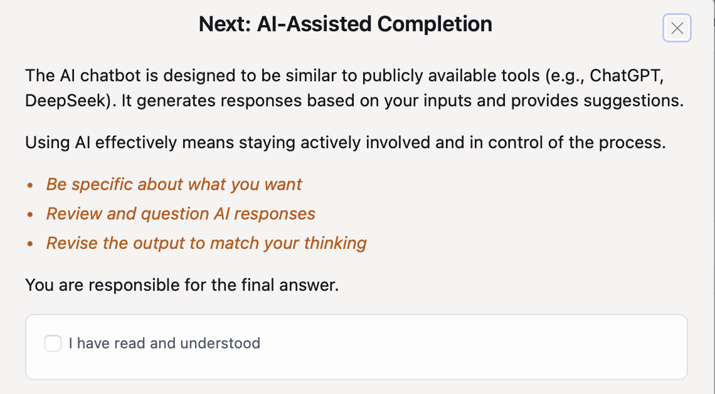
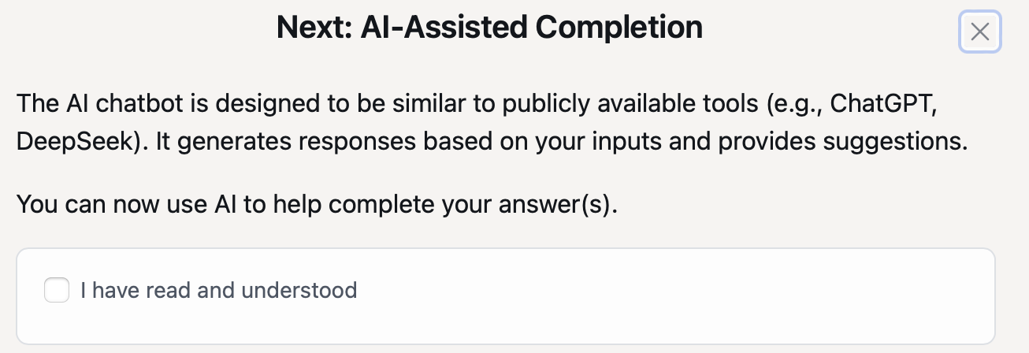
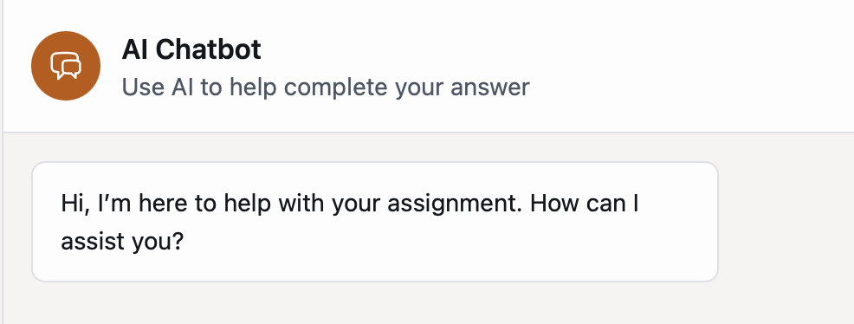
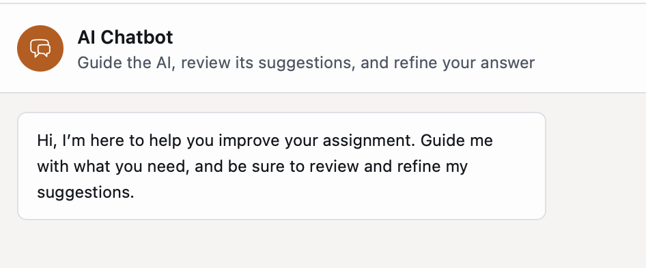






Treatment 2: Nudges to induce learner agency with AI
Non-agency group
Agency group

Slide 25
Category | Group | Definition | Agency
Question outsourcing | Question-based | Student pastes the assignment question and asks the AI to generate an answer with no independent thinking | Low
Targeted inquiry | Question-based | Student pastes the assignment question alongside a specific conceptual sub-question reflecting their own thinking | High
Conceptual inquiry | Question-based | Student asks a conceptual question from their own thinking, without pasting the assignment question | High
Surface refinement | Draft-based | Student provides a draft and asks AI to improve grammar, fluency, or formatting only | Neutral
Ideational outsourcing | Draft-based | Student provides a draft and asks AI to improve the ideas or argument without specific direction | Low
Feedback-seeking | Draft-based | Student provides a draft and asks AI for evaluative feedback or opinion | Neutral → HIgh
Targeted draft refinement | Draft-based | Student provides a draft and asks AI to address a specific weakness they identified | High
Iterative refinement | Follow-up | Follow-up that builds on or redirects a prior AI response by adding new direction or thinking | High
Clarification/re-asking | Follow-up | Follow-up that rephrases or repeats the prior request without adding new thinking | Neutral
Verification-seeking | Follow-up | Student critically examines an AI response by checking accuracy or requesting sources | High
Non-related/repeated | Other | Prompts unrelated to the task or resulting from confusion about the chatbot | Neutral
Notes:
principle of coming up with categories
how did we come up with this categories?
low agency – fully delegation of the task without cognitive involvement
high agency -
is it aligned with our intervention
what is the difference between delegation and low agency?? –

Slide 26
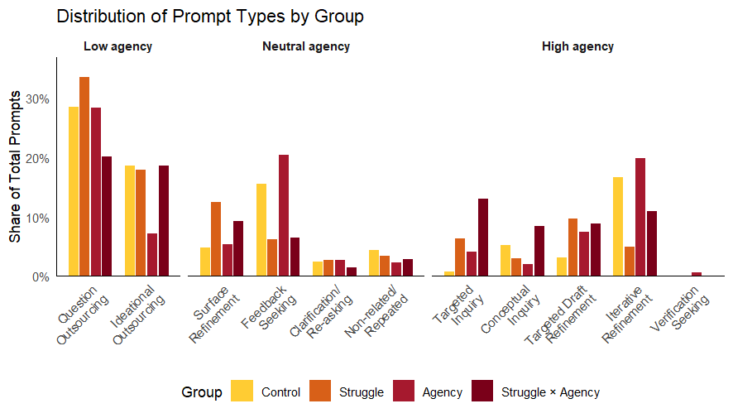
Results
Notes:
List high agency prompts + definition
List low agency + definition

