Slide 1

Masters Landscape
Sanjeev Dewan
Associate Dean, Masters Programs
IT Teaching Workshop, May 15, 2026

Slide 2
Trends & Disruptions
Steady decline in the number of MBA applications, especially for working-professional programs
  Rise in shorter and cheaper specialty-masters programs
  Decrease in employer’s willingness to subsidize costs of MBA education
New disruptions that threaten the future demand for MBA degrees
  Caps for Federal graduate student loans ($100K lifetime cap); AACSB research suggests this will impact 20-30% of MBA students
  Climate less friendly for foreign applicants
  Placement challenges, in part driven by AI
Heightened competitive actions by business schools
  Aggressive recruitment of applicants
  Flexible/online delivery
  Modified degree requirements (e.g., waiving GMAT, letters of recommendation)

Slide 3
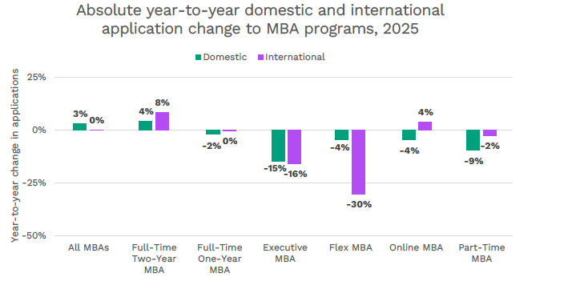
Decline in MBA Applications

Slide 4
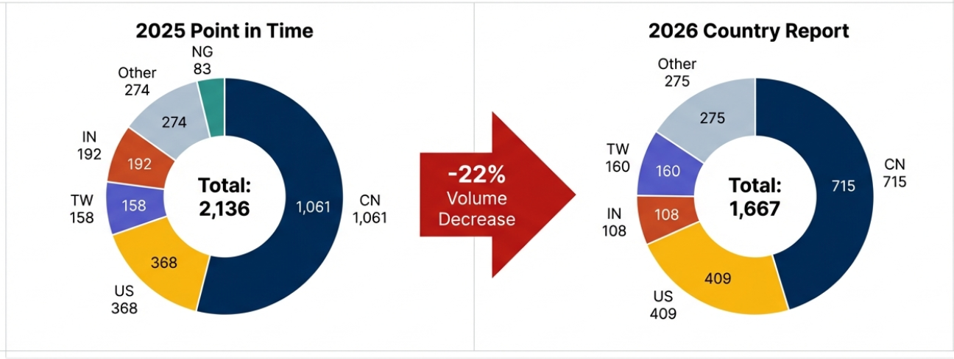
Decrease in International Applications

Slide 5
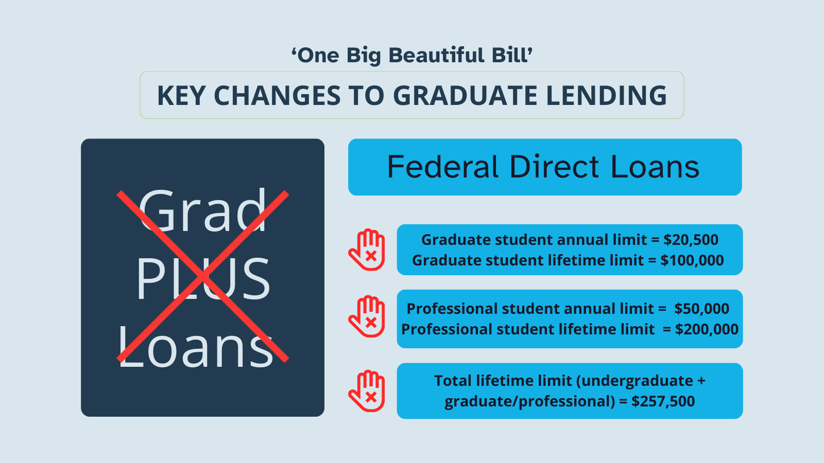
Changes in Federal Loans

Slide 6
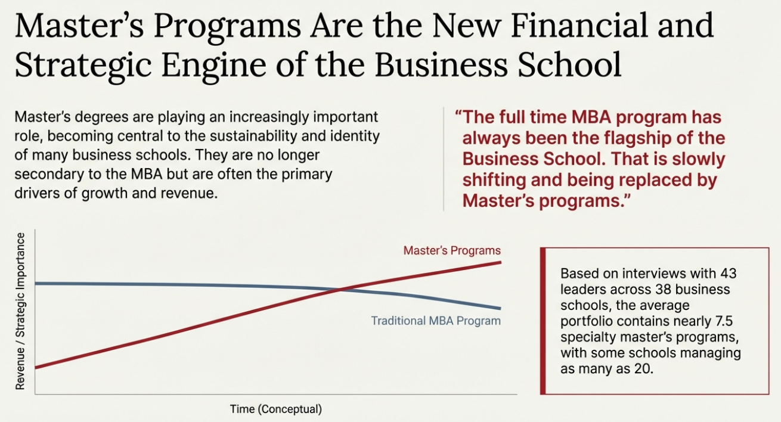
The Changing Market Landscape

Slide 7
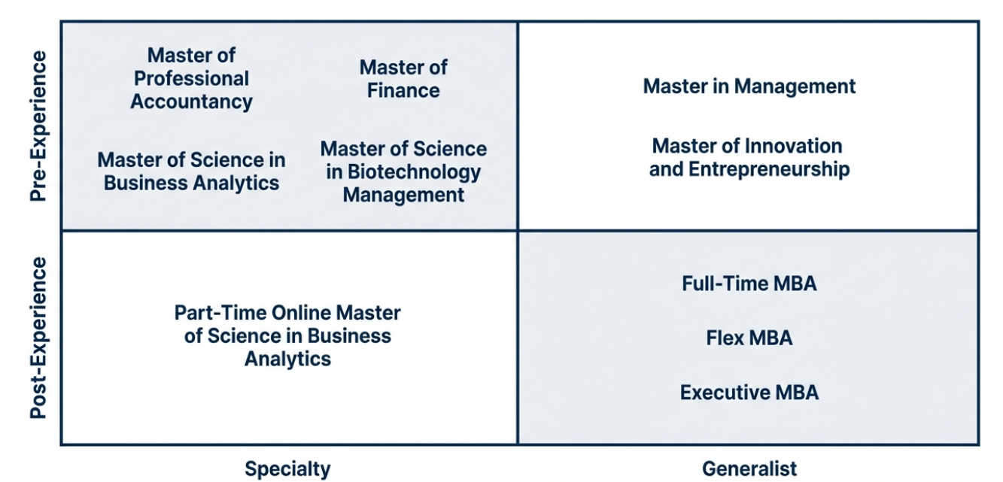
The Merage School Masters Portfolio

Slide 8
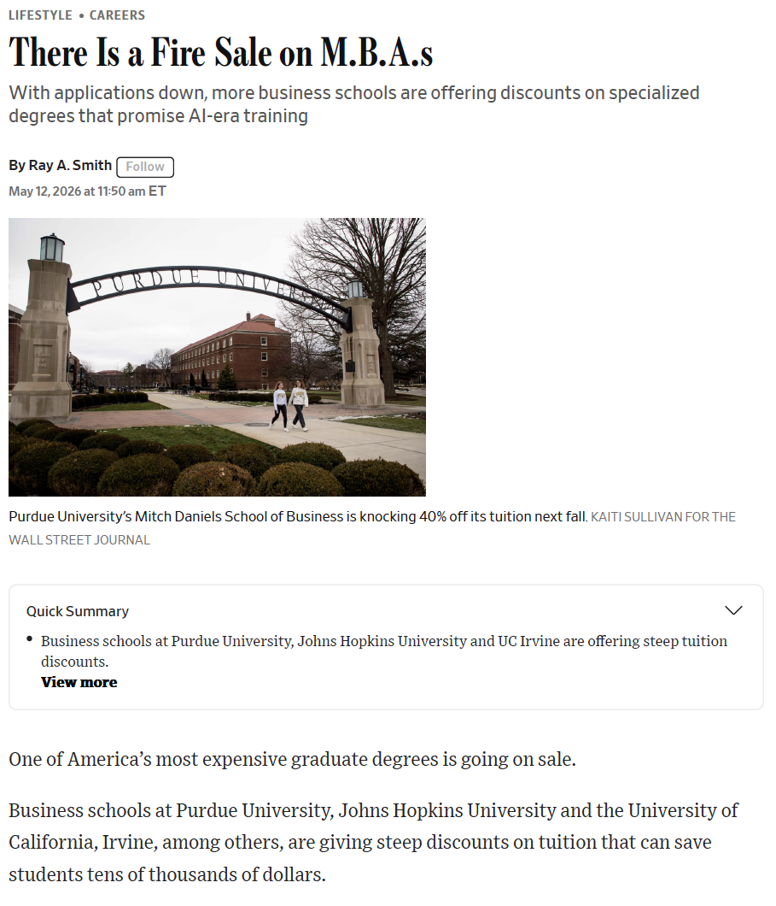

Slide 9
3 Archetypes for the Future of the MBA
Agile MBA
AI-Native MBA
Immersion MBA
Modular and adaptive
Flex for career development
Stackable credentials
Immediate workplace application
AI is a foundational capability
Highly adaptive
Judgement, ethics, decision-making
Human/AI integration
Sustained field work
Learning via problem solving
Coaching on long projects
Employers as partners

Slide 10
AI in the MBA Curriculum at Merage
New AI core course in all MBA programs, titled “AI for Management”
  Premise is that Gen AI is a general-purpose technology and driver of the next industrial revolution
  Course provides an overview of the technology underpinnings of AI (databases, cloud computing, LLMs and machine learning)
  Focus on how AI is transforming work in organization, and enabling value creation and capture
AI infused into other core classes
  The Operations Excellence course uses Simio simulation software (with AI as an embedded tool) to study process improvements
  The Strategic Management class studies AI as a core strategic force, with a capstone consulting project on AI-related strategic recommendations
AI in MBA electives (sample)
  AI and Strategy (AI-driven value creation)
  Competitive Intelligence (AI-driven competitive disruptions)
  Negotiations for Executives (Using LLMs as negotiation assistants)

Slide 11
Breakout Groups
(30-minute discussion + 30-minute debrief)
Ensuring Learning Outcomes (Groups 1 & 6)
  How do you make sure that learning outcomes are achieved, given that students are using AI for their assignments and projects?
Ensuring Career Outcomes (Groups 2 & 7)
  How do you make your graduates industry-ready when entry-level jobs are being transformed/automated by AI?
AI in the Curriculum (Groups 3 & 8)
  How does AI change what we teach in the core and elective curriculum? What experiential and co-curricular activities make sense?
Using AI for Teaching (Groups 4 & 9)
  What are the most effective ways for the use of AI in course design, delivery, and assessment?
AI Literacy (Groups 5 & 10)
  How do we continuously provide relevant AI literacy to students, staff and faculty?

